Slide 1

MIS 281N
Data Management
Class 8 – Data Warehouse ETL OLAP
Clint Tuttle
Senior Lecturer, The University of Texas at Austin
Brad Poynter
Lecturer, The University of Texas at Austin

Slide 2
Objectives
Introduction to Data Warehousing
Data Warehouse Physical Architectures
Extract, Transform, Load
OLAP
Questions and Discussion

Slide 3
Questions? Takeaways, Reflections

Slide 4
Brad Reflection – NoSQL Video
CPU is now most expensive
SQL and NoSQL are equally relational
ERD is still foundational
SQL & NoSQL awesome at OLTP
At web scale, SQL simply stops working
NoSQL is rigid and hard
Access patterns must be known in advance
Sure you can store anything anytime, but you can’t access it
SQL is AWESOME at ad hoc access

Slide 5
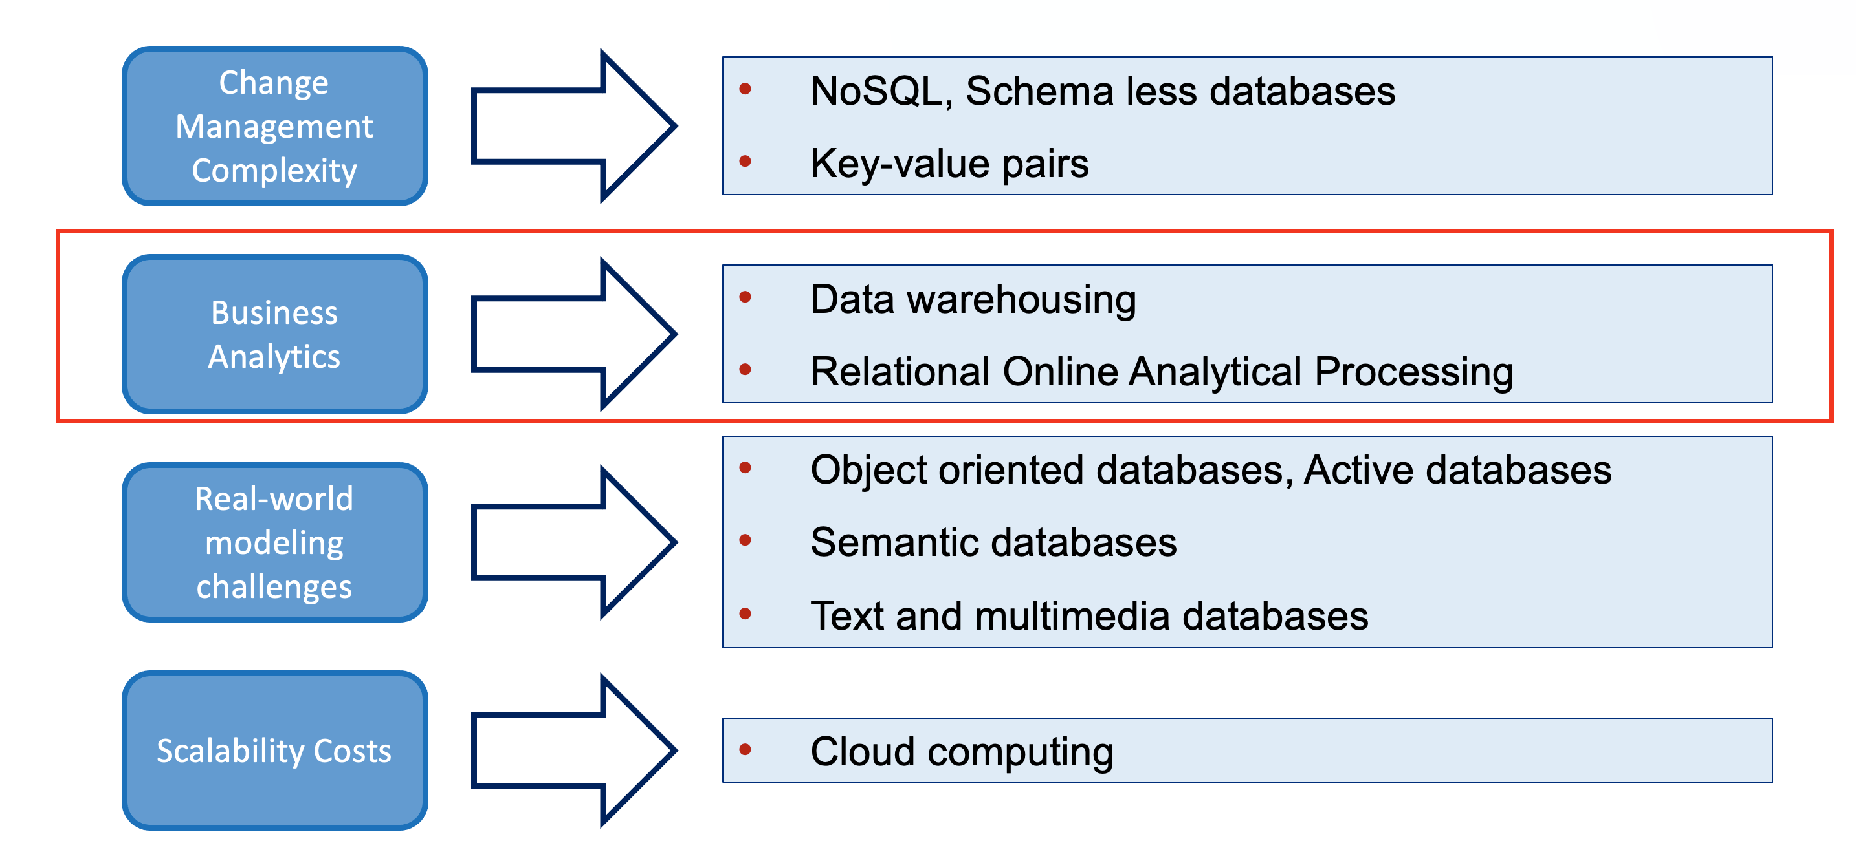
Issues with Relational Databases

Slide 6
Normalization
Pros
Reduce redundant data, increase data integrity
Can answer more questions
Fastest on insert and update
Cons
Harder to understand
Joins burn CPU

Slide 7
Denormalization
Pros
Read performance is FAST, no joins
Data easier to understand as related data is inline
Cons
Redundant data undermines integrity
Higher data storage costs

Slide 8
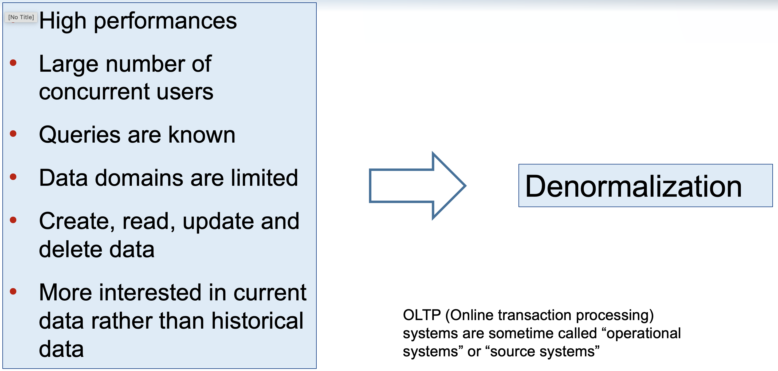
OLTP Needs

Slide 9
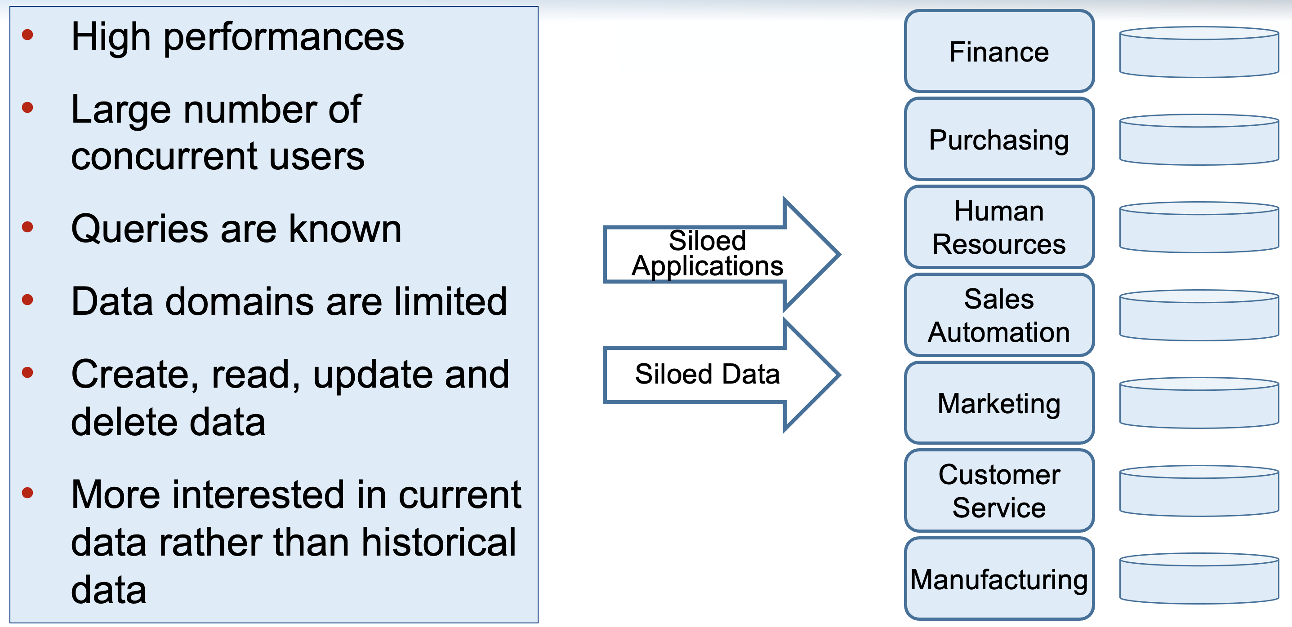
OLTP Reality

Slide 10
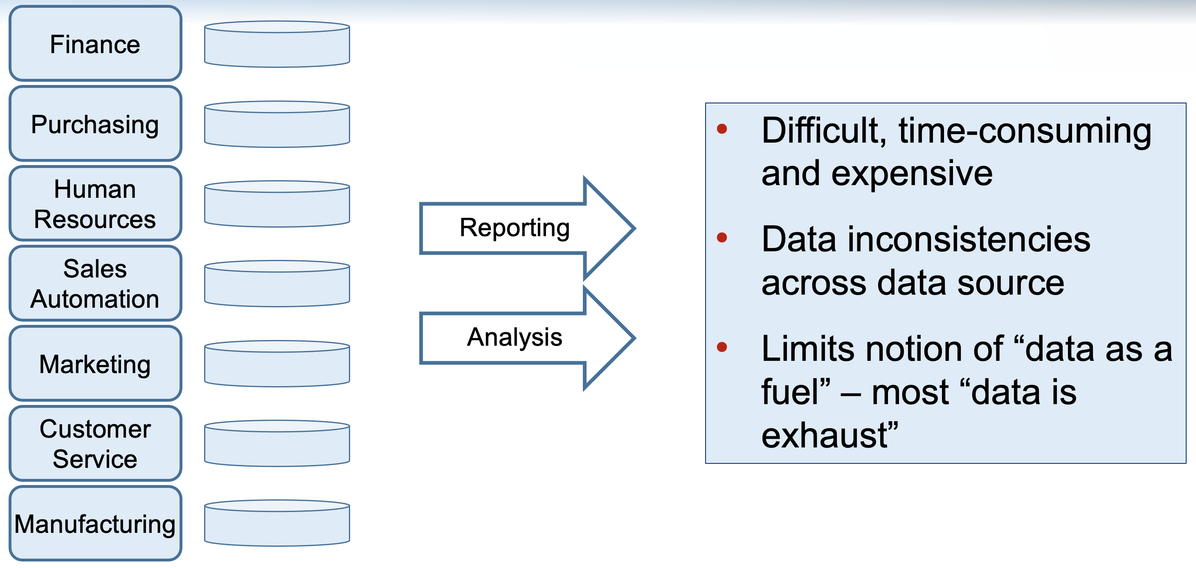
OLTP Reality

Slide 11
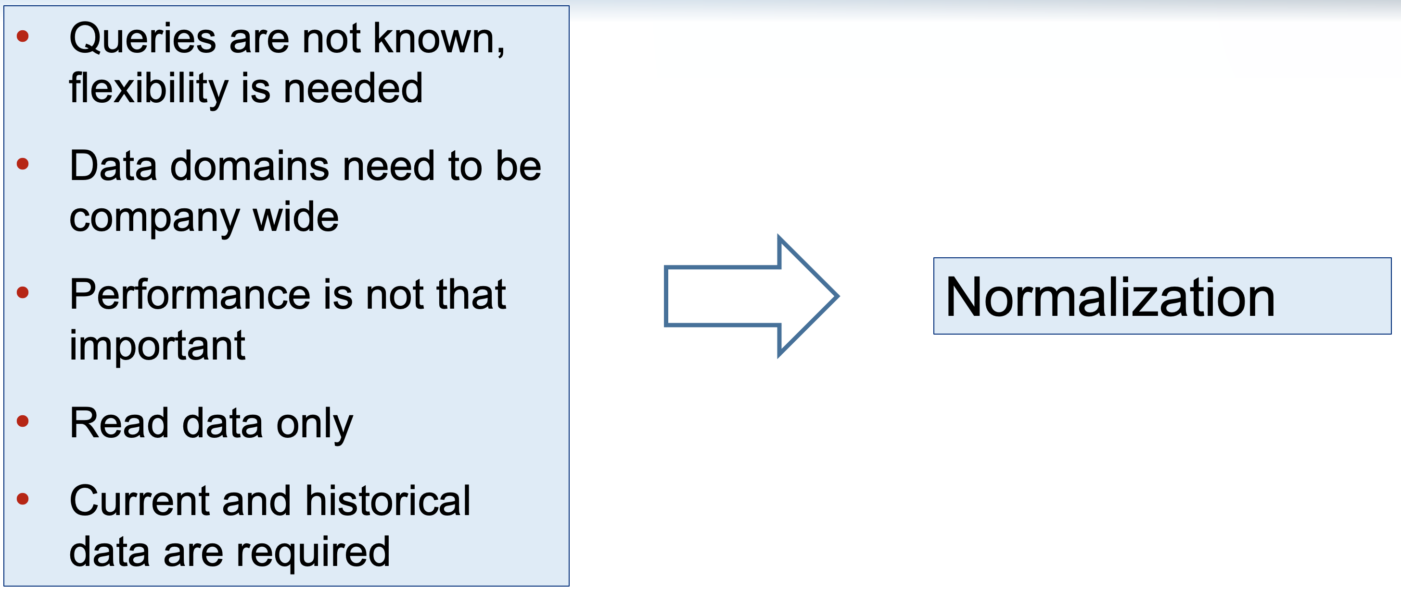
Analytics Needs

Slide 12
Data Warehousing

Slide 13
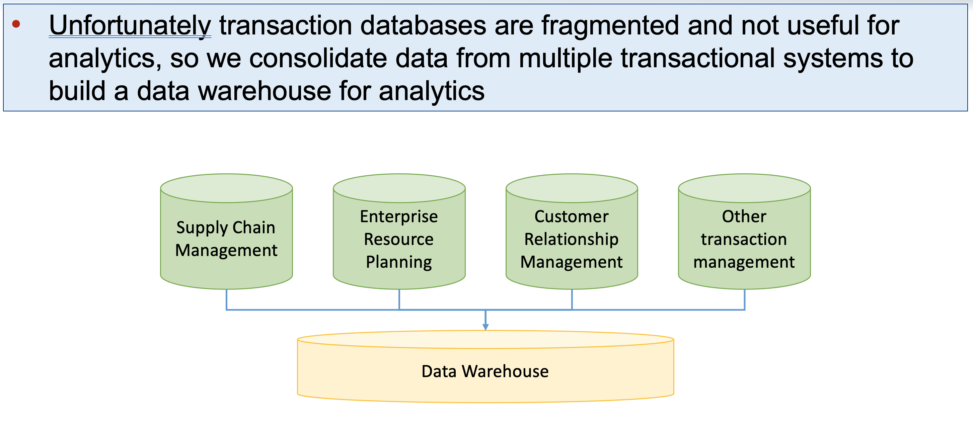
Converting Data into Information

Slide 14
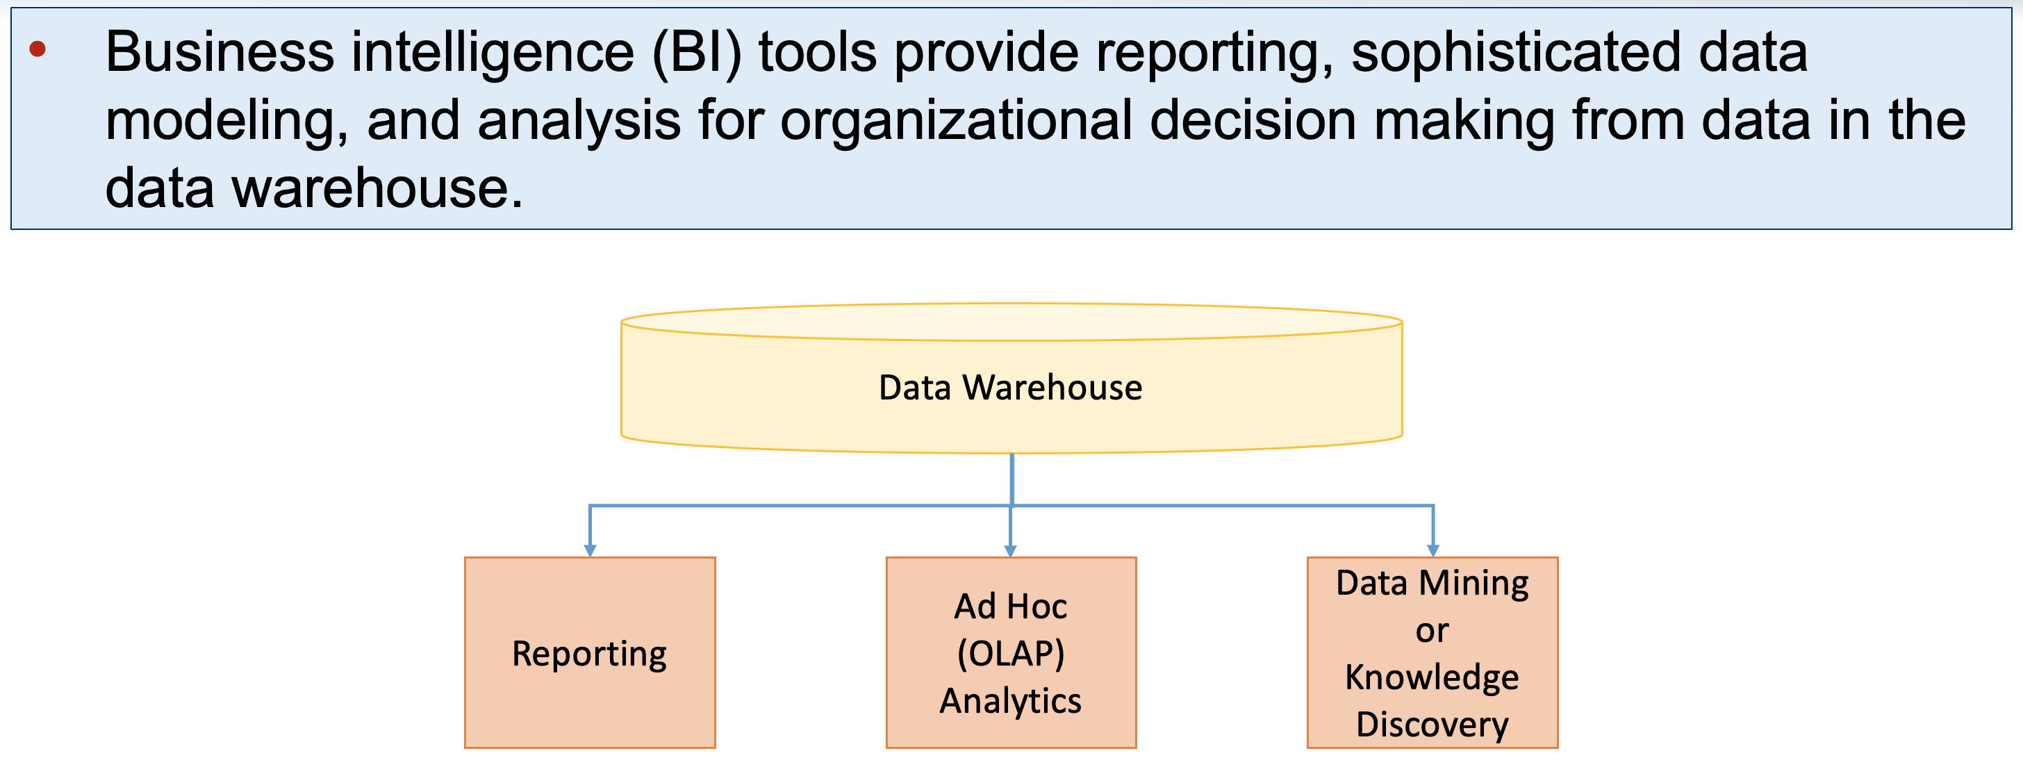
Business Intelligence

Slide 15
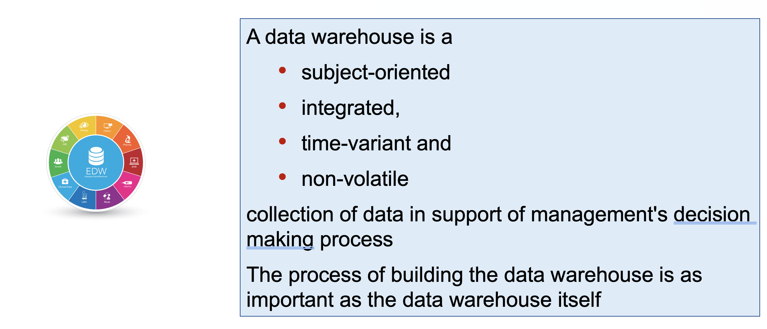
Warehouse Characteristics

Slide 16
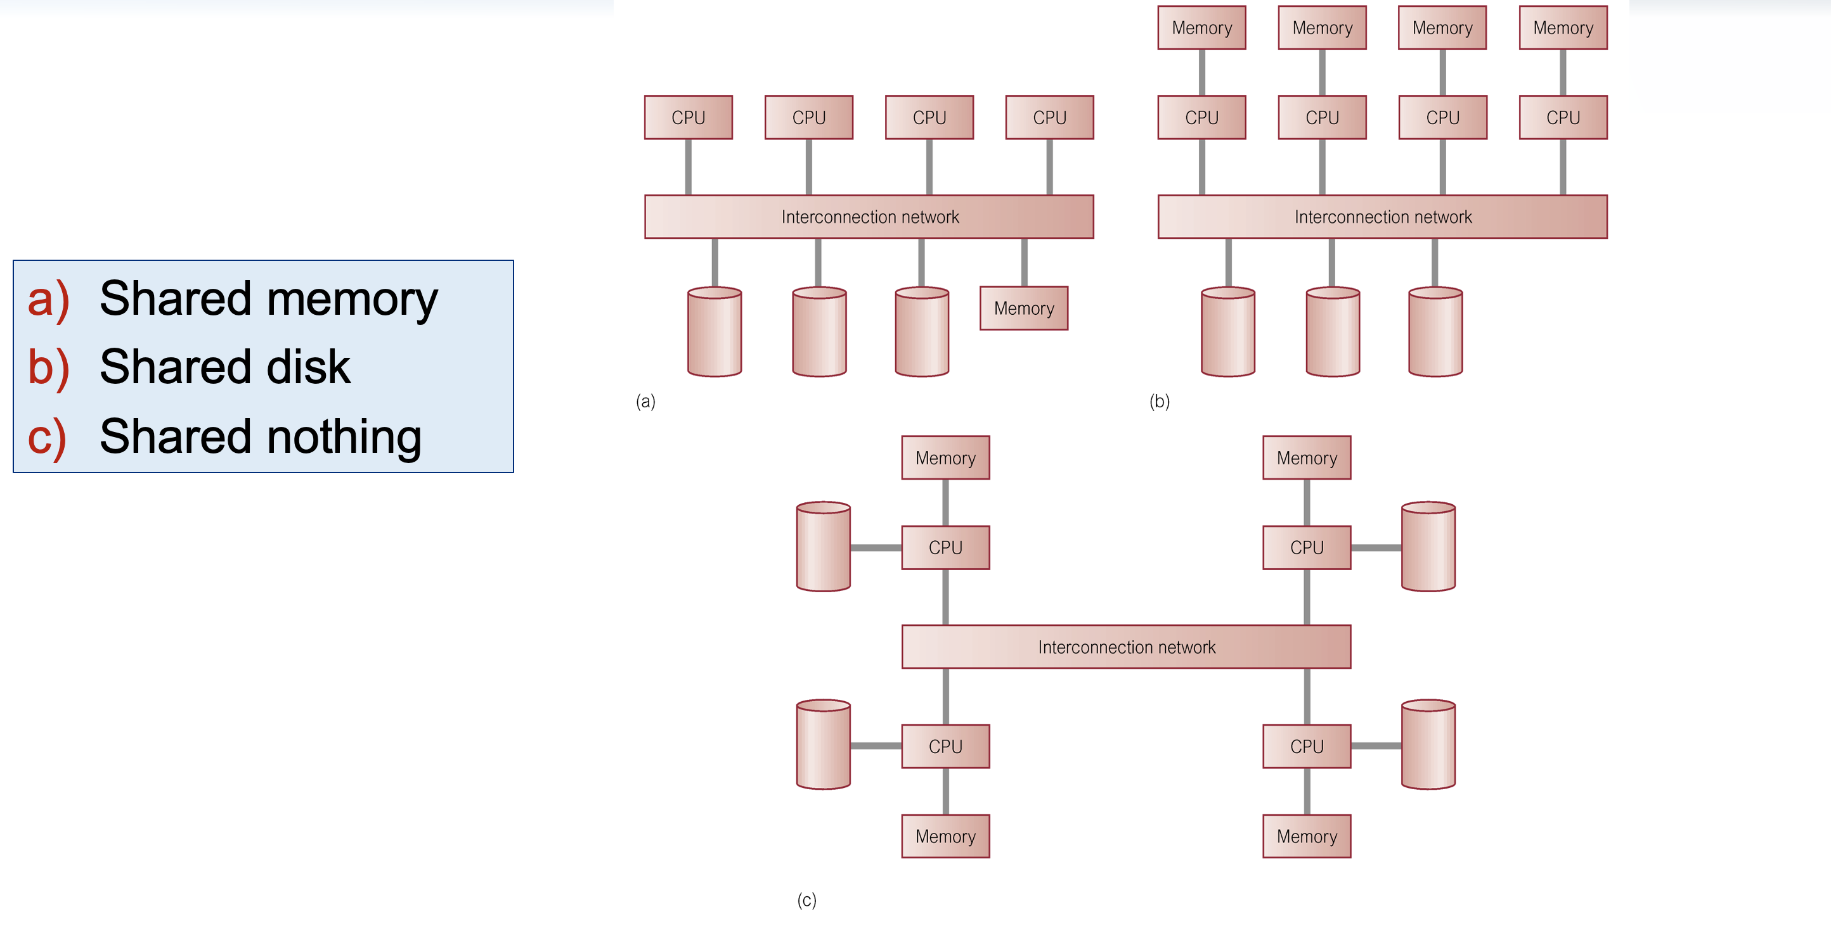
Parallel Database Architectures
Scaling UP - $$$$$
System Bus
System Bus
System Bus

Slide 17
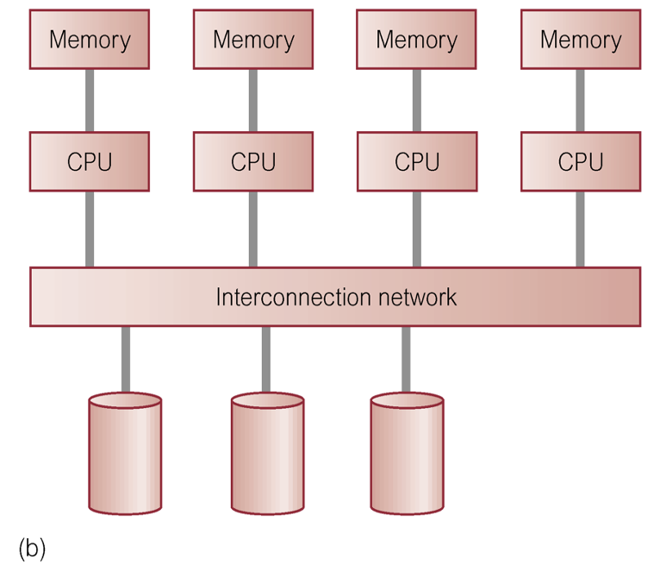
Separation of Compute and Disc
Massively Parallel – Scaling OUT - $-$$$$$
Cloud – Hybrid Cloud - Network – Internet – TCP/IP
CSV, Parquet, OPEN

Slide 18
ETL – Extract Transform LoAD

Slide 19
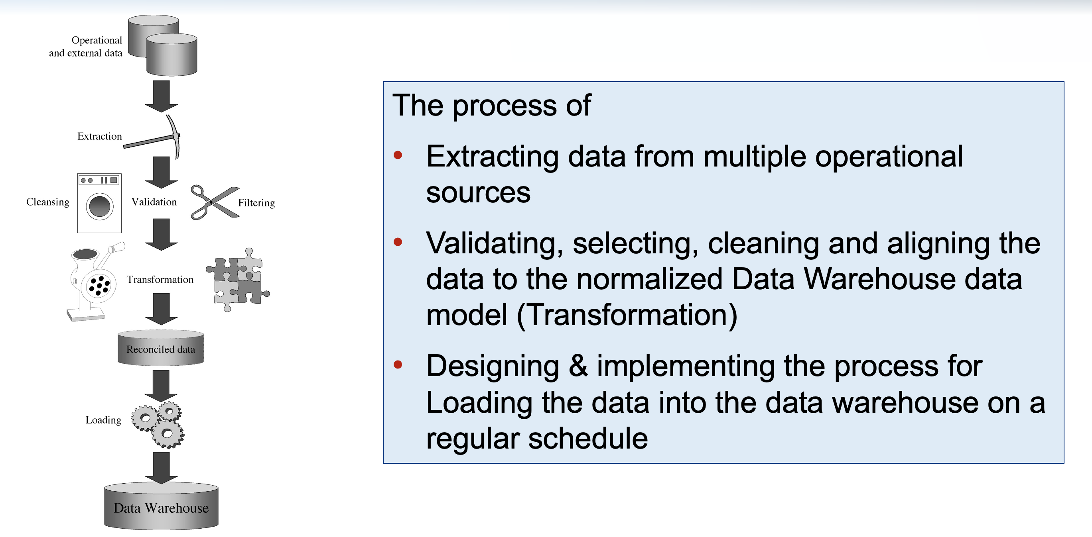
Extract Transform Load - ETL

Slide 20
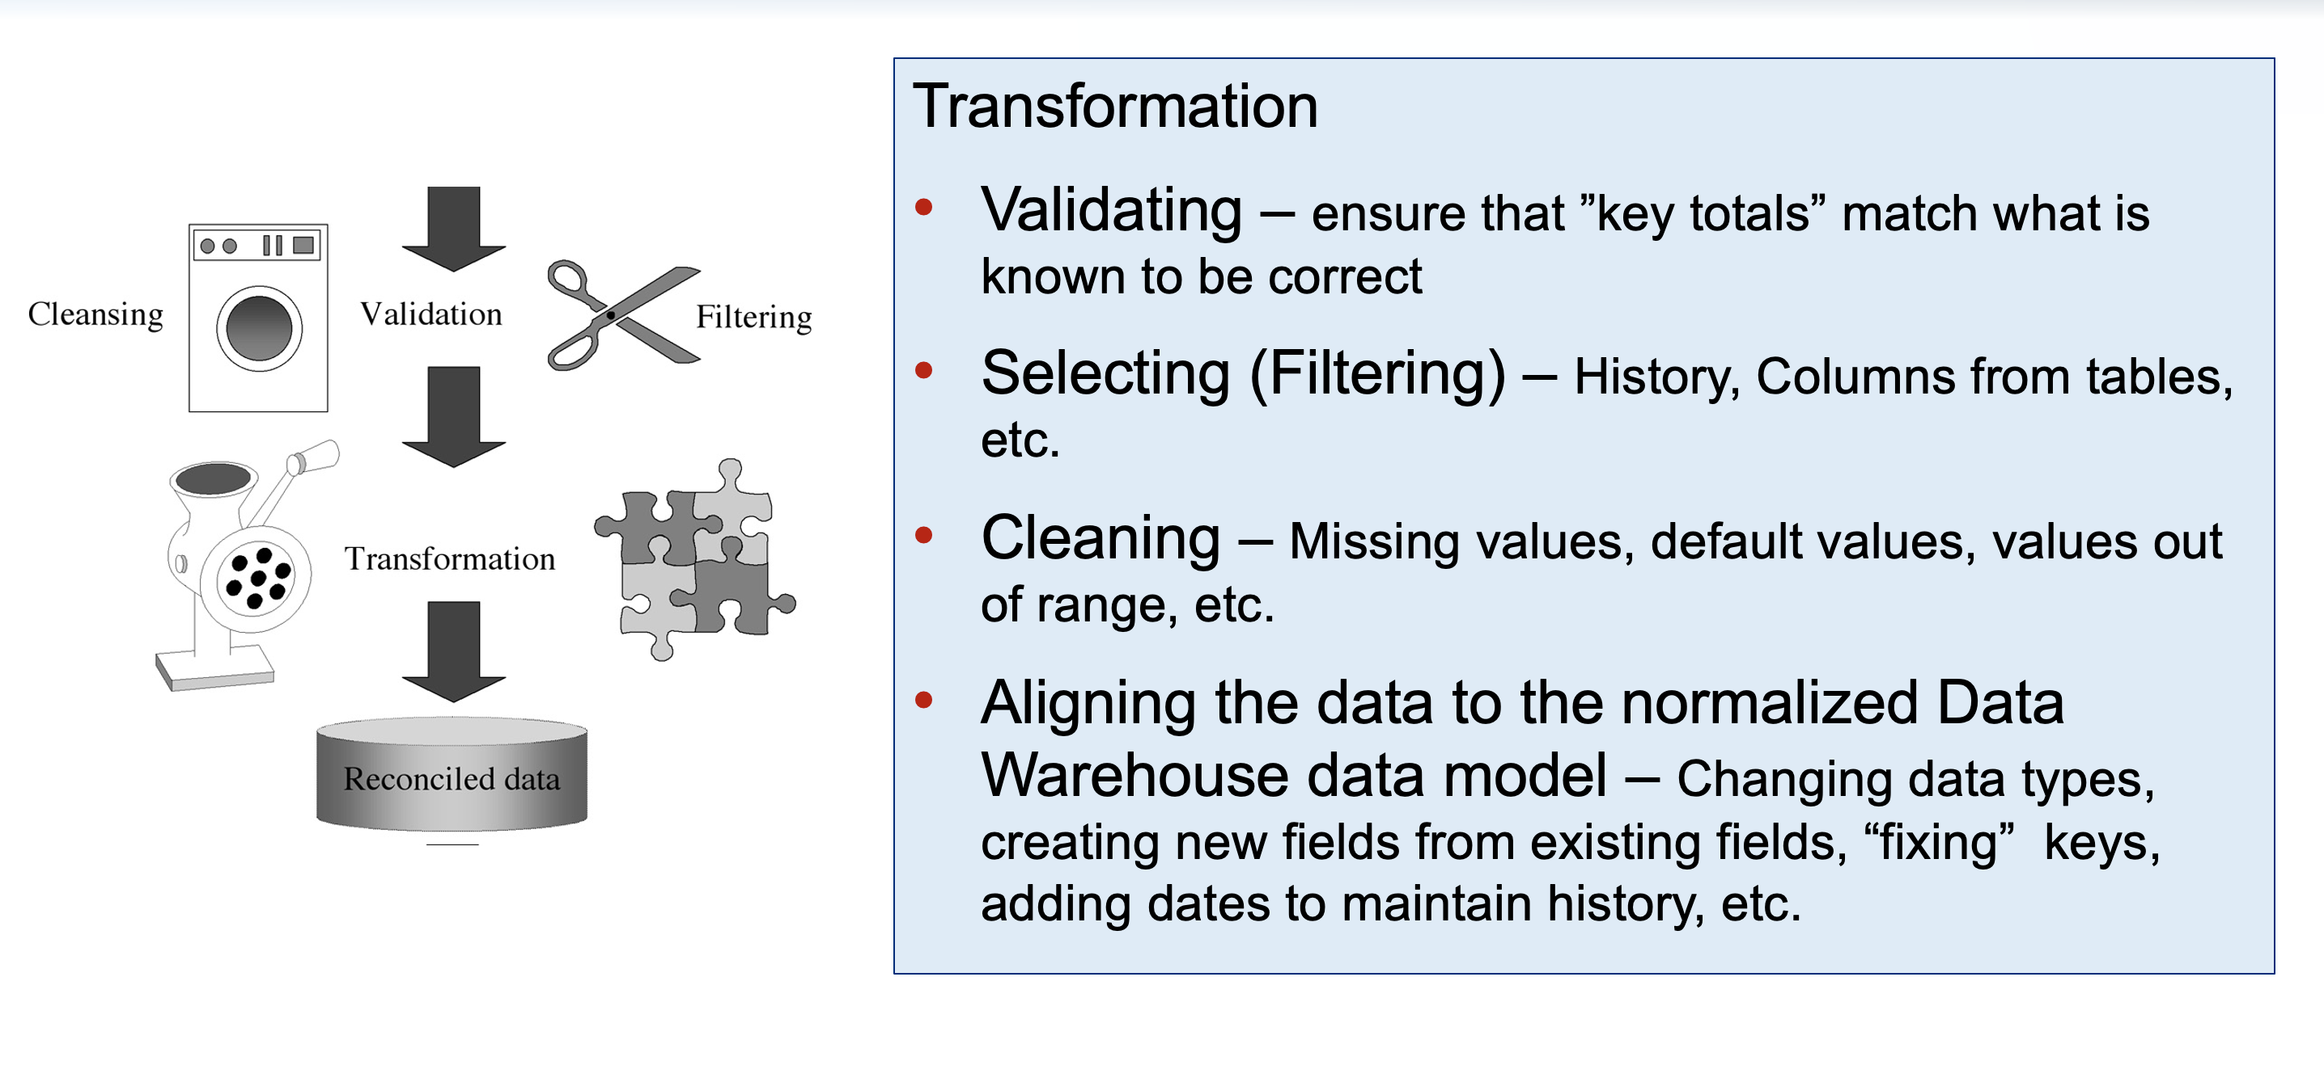
Transform

Slide 21
OLAP – Online Analytical Processing

Slide 22
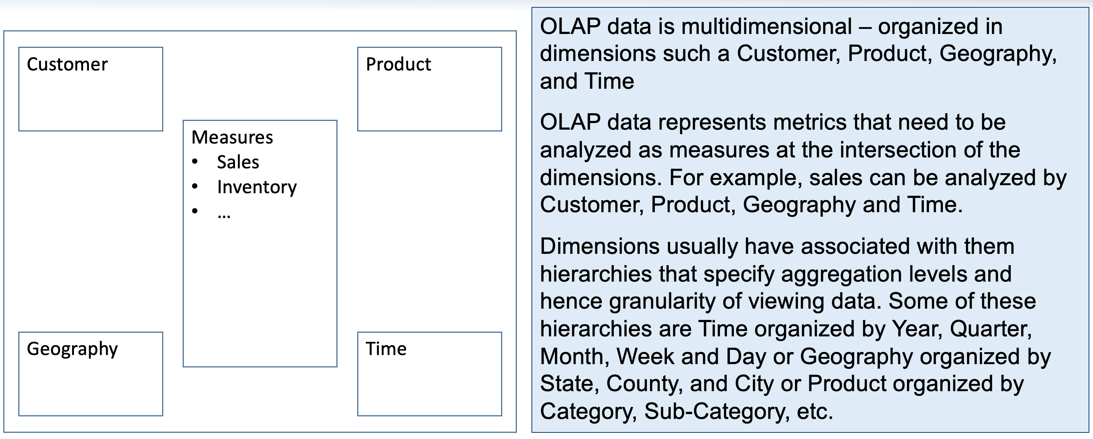
OLAP – Online Analytical Processing

Slide 23
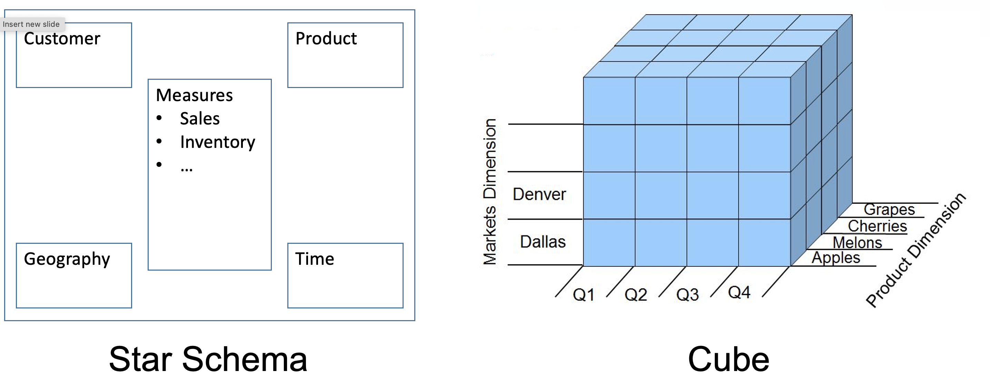
OLAP – Simple Retail Model

Slide 24
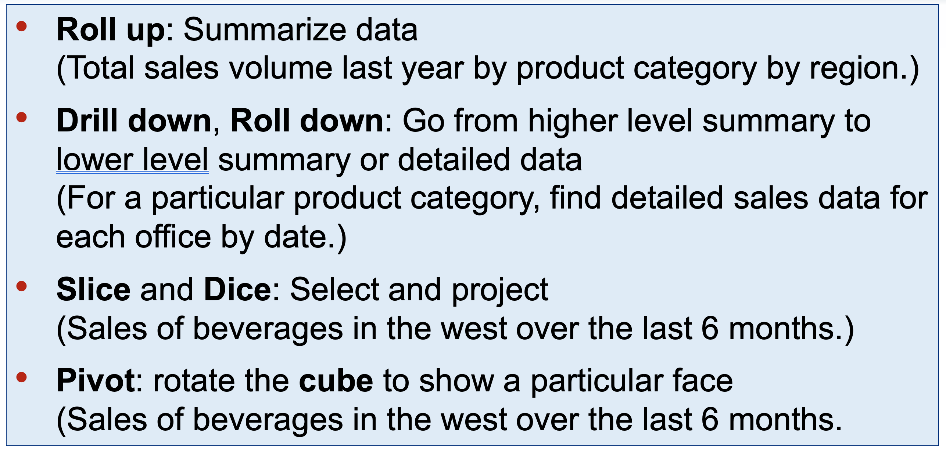
OLAP Operations

Slide 25
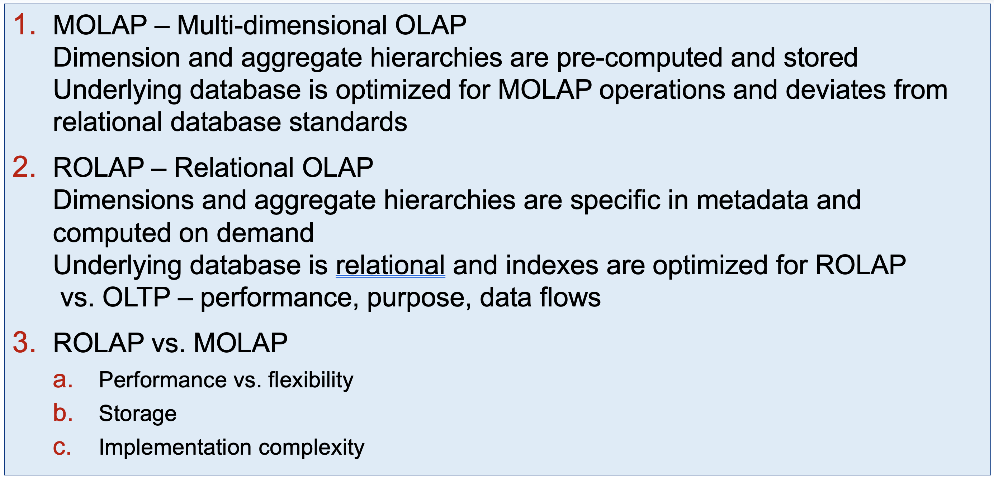
Types of OLAP

Slide 26
Next Class
Always on Canvas
Takeaways, Reflections, Questions – Due Sunday night
Prepare for Mid-term – next Wednesday 10/19
Teams and Final Project Spec will be published at 6 pm following Mid-term

